Slide 1







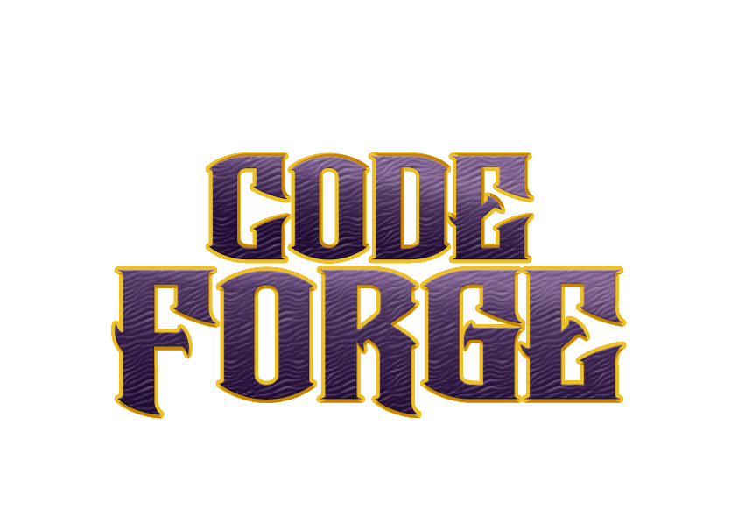

Idea submission

Slide 2


Team details
Team Lead:Name:Kashvi Agarwal
Contact: 7818951911
Email:kashviagarwal.cs23@bmsce.ac.in
Team Member 2:
Name:Chitrashree K
Contact: 7676963415
Email:chitrashreek.cs23@bmsce.ac.in
Team Member 3:
Name: Keerthi Reddy
Contact:9030339331
Email:kamireddy.cs23@bmsce.ac.in

Slide 3


Our solution
Issue:
Coronary Artery Disease (CAD) is one of the leading causes of death globally.
New diagnostic devices (angiography) are costly, invasive, and time-consuming
-High false-negative rates in early-stage detection.
Aim:
- Inexpensive, non-surgical CAD risk prediction through lab tests and patient history.
- Early identification of high-risk patients for preventive treatment.
- Influence:
- Eliminates unnecessary invasive procedures.
Improves patient outcomes with early intervention.

Slide 4

TECHNICAL APPROACH
Data Preprocessing: Processes missing values (median imputation for numeric, mode for categorical) and feature scaling (StandardScaler).
Feature Engineering: Extracts clinical indicators such as Cholesterol_Ratio and Metabolic_Score.
Model Training: Trains XGBoost with scale_pos_weight optimization for class imbalance, tested through stratified 5-fold cross-validation.
Web Integration:
Backend: Flask hosts predictions through a REST API (/predict endpoint).
Frontend: HTML/CSS form captures patient data; JavaScript retrieves predictions asynchronously.
Deployment: Saved as a.pkl with preprocessing pipeline for hassle-free inference. Metrics: ~80% accuracy, ROC-AUC 0.85, recall prioritized for high-risk cases.
Tools: Python, scikit-learn, XGBoost, Flask, Pandas

Slide 5
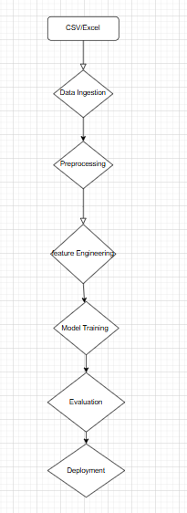
Workflow/pipeline

Slide 6
Feasibility & FUTURE SCOPE
Data Availability: Utilizes standard clinical data (no ancillary tests).
- Cost-Effective: Saves angiography costs by ~40% (estimated).
- Regulatory: HIPAA-compliant data management; model explainability aligns with FDA standards for AI in healthcare.
1. Integration:
- EHR Integration (Epic, Cerner).
- Software developed for medical professionals.
2. Advanced Models:
- Temporal data transformer models.
- Multi-hospital collaborative federated learning.
3. Extended Use Cases: - Forecast CAD progression phases.

